Slide 1
SECURE DATA HIDING IN IMAGES USING STEGANOGRAPHY
CAPSTONE PROJECT
Presented By: Aman Kumar Jha
Student Name : Aman Kumar Jha
College Name: Techno International New Town
Department : Computer Science and Business System

Slide 2
OUTLINE
Problem Statement
Technology used
Wow factor
End users
Result
Conclusion
Git-hub Link
Future scope

Slide 3
Problem Statement
Confidentiality: Ensuring that sensitive information is securely hidden within images to prevent unauthorized access.
Integrity: Maintaining the quality and integrity of the original image while embedding the hidden data.
Detection Resistance: Making the hidden data undetectable to unauthorized users, ensuring that the presence of hidden information is not easily discovered.

Slide 4
Technology used
Programming Language: Python
Image Processing Library: CV2
IDE: VS Code
Platform: Windows 11

Slide 5
Wow factors
Hidden in Plain Sight: The ability to hide sensitive information within everyday images makes the hidden data practically invisible to unintended viewers.
Versatility: The broad range of applications—from military to personal privacy—highlights the project's wide-reaching impact and importance.
High Security: Steganography offers an additional layer of security, working alongside traditional encryption methods to provide a robust defense against data breaches.
Innovation: Advances in steganographic algorithms demonstrate cutting-edge technology and creative thinking to stay ahead of detection methods.

Slide 6
End users
Government Agencies: To ensure confidential communication and secure sensitive data.
Military Organizations: For secure transfer of strategic information and intelligence
Journalists and Activists: To protect the anonymity and confidentiality of sensitive information and sources.

Slide 7
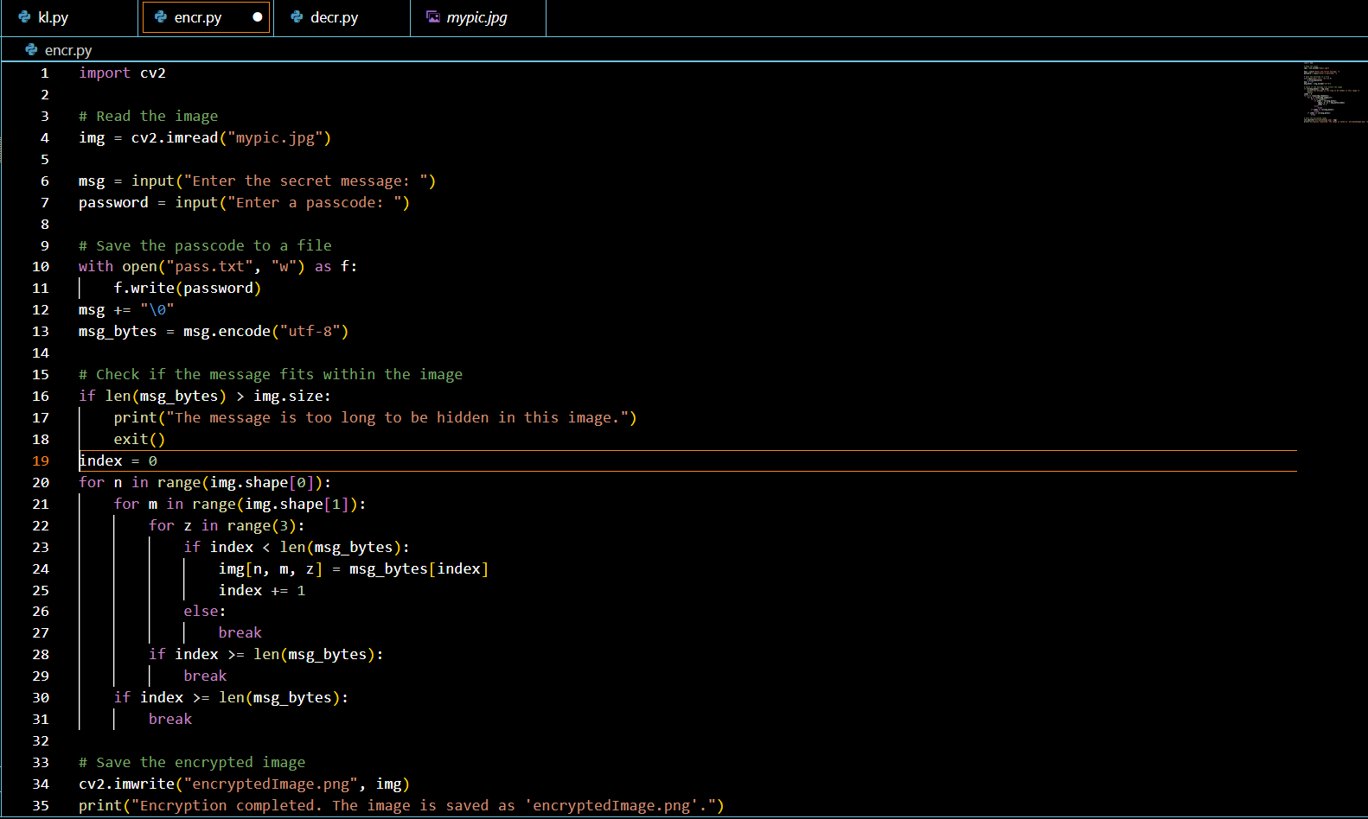
Results
Encryption Code:

Slide 8

Results
Decryption Code:

Slide 9
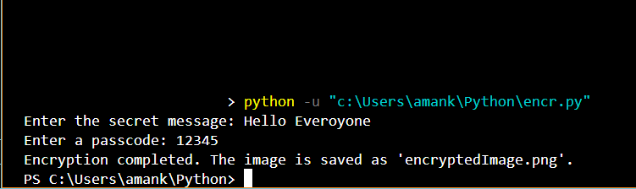
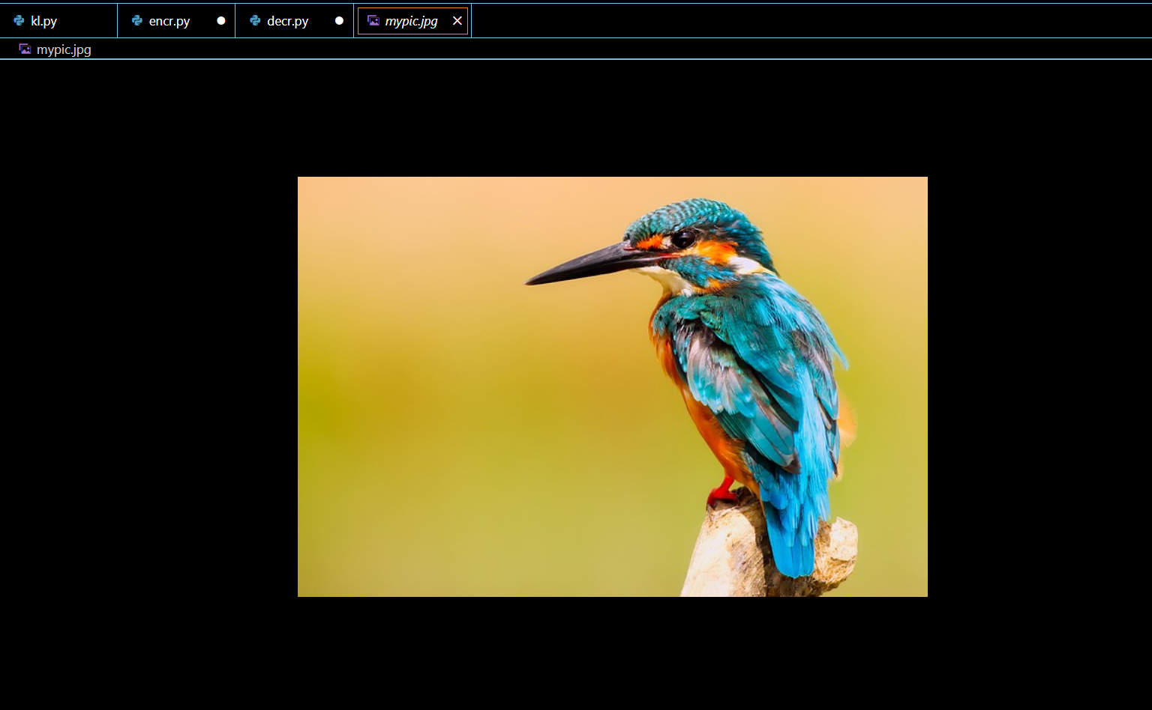
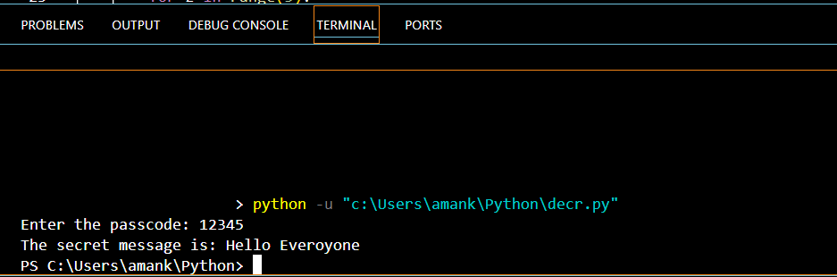
Results
Image: Output:

Slide 10
Conclusion
Effective Security: Steganography provides an additional layer of security by embedding confidential data within images, making it difficult for unauthorized users to detect or access the hidden information.
Data Integrity: The techniques used in steganography ensure that the quality and integrity of the original image are preserved, allowing the hidden data to remain secure without compromising the visual quality of the image.
Enhanced Privacy: By making the hidden data undetectable to unauthorized users, steganography enhances privacy and confidentiality, providing peace of mind for individuals and organizations.

Slide 11
GitHub Link
https://github.com/AmanJha-45/Project-Stego.git

Slide 12
Future scope(optional)
Advanced Algorithms: Development of more sophisticated and robust steganographic algorithms that can resist advanced detection techniques and attacks.
Enhanced Usability: Developing user-friendly tools and interfaces that make steganography accessible to non-experts, allowing wider adoption and application of the technology.
Interdisciplinary Research: Encouraging collaboration between cryptography, computer science, and other fields to innovate and improve steganographic methods and applications.
AI and Machine Learning: Integration of AI and machine learning to enhance steganography by automatically detecting the optimal methods and parameters for data embedding and extraction.

Slide 13
THANK YOU

